Slide 1


SDP
LECTURE
The Strategy Design Pattern
Software Design Principles
Diploma in IT
Year 2 (2024/25), Semester 4
3.2
Notes:
Hi everyone! Let’s now look at our second design pattern, and it’s called the Strategy design pattern. We are going to jump right in with a nice, easy to understand example problem…

Slide 2
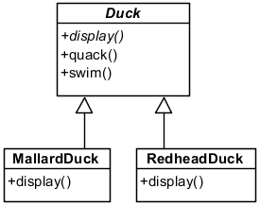
Example Problem – Duck Sim
You are designing a simulation game involving ducks
Initial design:
… (other ducks)
Notes:
…About ducks. Hey, at least everybody knows what’s a duck, right?
OK, so in this example, you are designing a simulation game involving ducks. And || here is the initial design. We have an abstract class Duck, so we cannot instantiate an object of type Duck. We also have multiple classes inheriting from Duck, such as MallardDuck, RedheadDuck, and lots of other types of ducks. We see that the Duck class has an abstract operation display(), so each class that inherits from duck must override it. Every duck also has two non-abstract operations quack() and swim(), so all duck subclasses will inherit those operations. This looks pretty good, right?

Slide 3
Example Problem – Duck Sim
abstract class Duck {
public abstract void display();
public void quack() {
Console.WriteLine("Quack");
}
public void swim() {
Console.WriteLine("Splish splash");
}
}
class MallardDuck: Duck {
public override void display() {
// implementation
}
}
Notes:
And you all know how to do code engineering to produce C# code from the class diagram, which we show here. We have an abstract class Duck with an abstract operation display() as well as two concrete operations quack and swim. We also have a class MallardDuck that inherits from Duck and overrides the display() operation. So far so good – we’ve designed the classes, coded them, and can now go out for pizza.

Slide 4
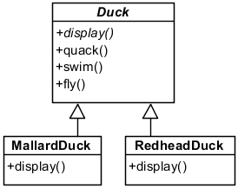
New Requirement
New requirement: now ducks can fly
New design:
newly added method
… (other ducks)
Notes:
But of course, just when we thought our job was done, a new requirement comes in. We now want ducks to be able to fly. That sounds pretty simple – we can just add a || fly() operation into the Duck class, and now all ducks can fly. That took 10 seconds, and we can get back to our pizza.

Slide 5

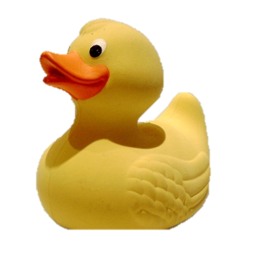
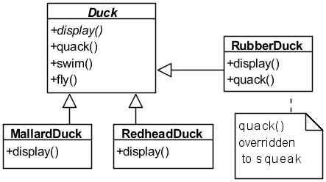
New Requirement
Oops! Now rubber ducks can fly!
Notes:
Oopsie! Apparently, one of the ducks in the game is a rubber duck. By adding the fly() operation to the Duck base class, we now have flying rubber ducks, which is not what we want. In the old design, we could have our RubberDucks inherit from the Duck class because RubberDucks do swim, and we can override the quack() method so that RubberDucks squeak when quack() is called. But with the new requirement, we just introduced an unforeseen issue of flying rubber ducks.

Slide 6
New Requirement
We can override the fly() method in RubberDuck to do nothing (like for quack())
But what if there are new duck types?
E.g., DecoyDucks don’t fly and don’t quack
E.g., SuperDucks fly using rockets
Notes:
We could of course use the overriding trick that we used before. Since we can override the RubberDuck’s quack() method so that it squeaks, we could also override its fly() method to do nothing. But this could start to get rather tedious. In the next DLC, we could be coming up with all sorts of ducks. There could be || wooden DecoyDucks that don’t fly and don’t quack, or we could even introduce || SuperDucks that fly in a whole new way using rockets. Every time we introduce a new type of duck, we would have to override their default fly and quack behaviour, which is a lot of work.

Slide 7
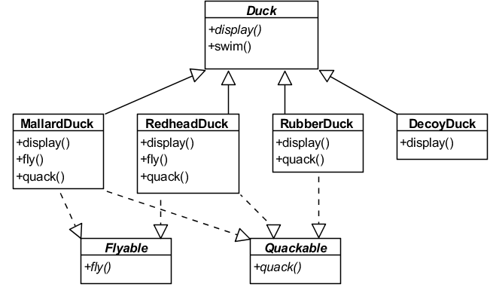
2nd Attempt
What if we use interfaces?
What do you think of this design?
Notes:
OK then, this looks like a job for interfaces. Maybe we can come up with a Flyable interface and a Quackable interface, and all ducks that fly have to implement Flyable, while all ducks that quack have to implement Quackable. So MallardDuck and RedheadDuck will implement both Flyable and Quackable since they both fly and quack. And since a || RubberDuck quacks but does not fly, it will implement Quackable but not Flyable.
So, what do you think of this design?

Slide 8
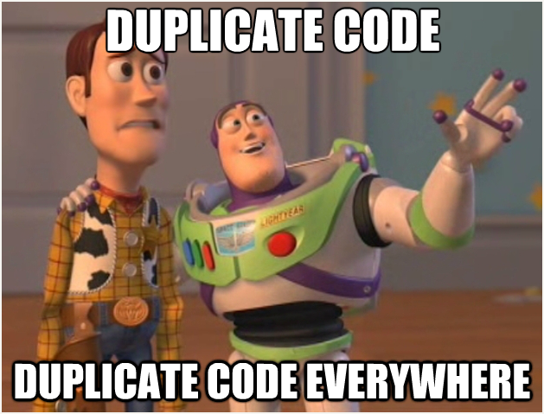
2nd Attempt
You have to override flying/quacking behavior for all ducks, even if they fly or quack normally
Generated by www.mememaker.net
Notes:
Unfortunately, there is a major issue with this design. By forcing all ducks to implement an interface, it means that even for ducks that fly or quack normally, we still need to override the flying and quacking behaviour. So if we have 50 different types of ducks that fly normally, we will need to re-code that same flying behaviour 50 times. That’s a looooot of duplicate code.

Slide 9
Let’s Apply a Design Principle
Principle: “Encapsulate what changes”
Identify the aspects of your application that vary and separate them from what stays the same
What changes in the duck simulation?
fly()
quack()
Pull these methods out of Duck and into a new set of classes
Notes:
So what do we do? Let’s introduce another OO design principle, which is || “Encapsulate what changes”. This means that we should identify aspects of our system that varies and separate them from what stays the same. This is one of the most important OO design principles, and we will apply this one all the time.
Looking at our duck simulation, || what changes, and what stays the same? We know that || fly() changes, because some ducks fly with wings, some with rockets, and some can’t fly at all. We know that || quack() changes, because some ducks squeak instead of quack. What stays the same? We know that all ducks need a display() method, and for now we can assume that all ducks swim. Following the principle of “encapsulate what changes” , we should therefore || pull the fly() and quack() methods out of Duck and into a new set of classes.

Slide 10
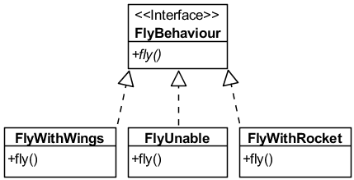
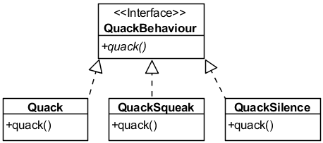
FlyBehaviour and QuackBehaviour
Notes:
By combining this principle with the previous principle we introduced of coding to an interface instead of an implementation, we come up with this design, which uses an interface to represent each behavior. Take a look at FlyBehaviour, which is an Interface with the method fly(). There are different classes that implement FlyBehaviour, namely FlyWithWings, FlyUnable and FlyWithRocket. They each implement fly() in a different way. We do the same thing with QuackBehaviour that implements different types of quacking. In our previous designs, each type of duck has to implement its own version of flying and quacking – that’s coding to an implementation, and when we do that, we will have to write more code each time we introduce a new duck. In this design, we have encapsulated the fly and quack behaviours into their own interfaces, so the actual implementation of the behavior (in this case, the subclasses of the FlyBehaviour and QuackBehaviour) won’t be locked into the Duck subclass. Now let’s see how we use this design.

Slide 11
FlyBehaviour Code
public interface FlyBehaviour {
void fly();
}
class FlyWithWings: FlyBehaviour {
public void fly() {
Console.WriteLine(“Flap flap”);
}
}
class FlyWithRocket: FlyBehaviour {
public void fly() {
Console.WriteLine(“Zooooom!”);
}
}
Notes:
This is how we would write the C# code for the classes. The interface class has the fly() abstract method and its subclasses implement the fly() method according to the desired concrete behavior. We would do something similar for QuackBehaviour.

Slide 12
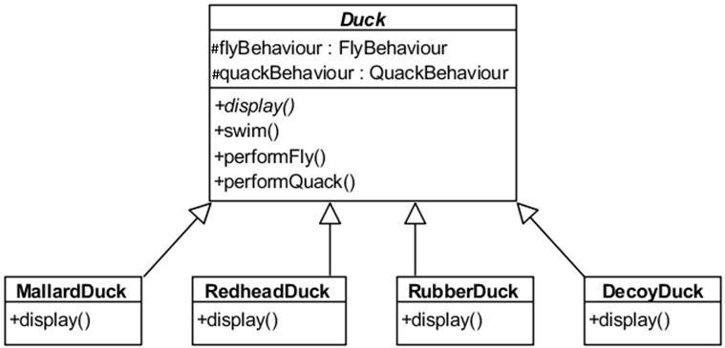
Integrating Duck Behaviour
Duck now has FlyBehaviour
and QuackBehaviour interface
types as attributes
These methods replace
fly() and quack()
Notes:
And now, I present the new Duck class. This version of Duck has || two attributes of type FlyBehaviour and QuackBehaviour, which are interfaces. We can assign any object that implements that interface to that attribute. For example, for the flyBehaviour attribute, we could assign an object of type FlyWithWings, FlyWithRocket or FlyUnable. Furthermore, the Duck class no longer has the fly() and quack() methods. These methods will be encapsulated in the FlyBehaviour and QuackBehaviour classes. Instead, we || have two similar methods called performFly() and performQuack().

Slide 13
Integrating Duck Behaviour
abstract class Duck {
protected FlyBehaviour flyBehaviour;
protected QuackBehaviour quackBehaviour;
public void performFly() {
flyBehaviour.fly();
}
public void performQuack() {
quackBehaviour.quack();
}
public void swim() { // all ducks swim
Console.WriteLine(“Splish splash”);
}
}
Notes:
And here is the code for our new Duck class. We see that Duck has two attributes of types FlyBehaviour and QuackBehaviour. In this case, we made it protected so that it is easy for subclasses to access. The cool thing is how performFly() and performQuack() works. Notice that || performFly() only has one line of code: flyBehaviour.fly(). Since flyBehaviour is an Interface, it can take any object that implements it. So when performFly() is called, if flyBehaviour happens to be a FlyWithWings object, the duck will go “Flap flap”, but if it’s a FlyWithRocket object, it will go “Zoooom!”. Same goes with quacking. On the other hand, assuming all ducks swim the same way, we can still provide a || concrete implementation of swim() that all Ducks share. Since swim does not change, we do not have to pull it out of Duck.

Slide 14
Integrating Duck Behaviour
class MallardDuck: Duck {
public MallardDuck() { // constructor
flyBehaviour = new FlyWithWings();
quackBehaviour = new Quack();
}
}
class RubberDuck: Duck {
public RubberDuck() { // constructor
flyBehaviour = new FlyUnable();
quackBehaviour = new QuackSqueak();
}
}
Notes:
Finally, let’s see how we assign fly and quack behavior to each duck subclass. The easiest way is to assign the appropriate behaviours in their constructors. A Mallard duck flies with its wings and quacks, well, like a duck. So in our MallardDuck constructor, it initializes the MallardDuck’s inherited flyBehaviour attribute to a new instance of FlyWithWings(), and the quackBehaviour attribute to a new instance of Quack().
But for the RubberDuck, its constructor instead assigns to it the flyBehaviour of FlyUnable() and the quackBehaviour of QuackSqueak(). And we would do this for all ducks, assigning to them the appropriate fly and quack behaviours.

Slide 15
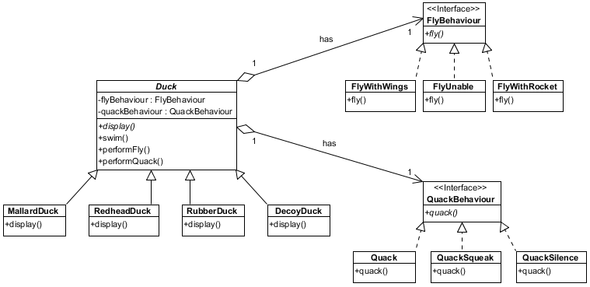
Overall Class Diagram
Encapsulated Fly Behaviour
Context
#
#
Encapsulated Quack Behaviour
Notes:
Here is the updated class diagram. Now the behaviours of ducks are not in the duck classes, but have instead been || encapsulated into their own classes. We now have a family of algorithms that represent things a duck could do, which is to quack and fly in different ways. We call the classes that use these encapsulated behaviours the || Context, so in our case, all the ducks are part of the context that use duck behaviours.

Slide 16
What Have We Achieved?
Other classes can reuse our fly and quack behaviours
No longer hidden in our Duck classes
When we add new behaviours, we
Don’t have to modify any existing behaviours
Don’t have to modify any Duck subclasses
Notes:
Let’s summarize why our new design is superior by listing out what we have achieved. Firstly, by putting fly and quack behaviours into their own classes, now || other classes can reuse our fly and quack behaviours as they are no longer hidden in the Duck classes. In the upcoming pigeon DLC for our game, we can reuse all the fly behaviours without having to recode them.
Secondly, we can now || add new behaviours without modifying any existing behaviours. If we want to allow the possibility of flying with balloons, we just need to create a new FlyWithBalloons class that implements FlyBehaviour. None of the other Flybehaviour subclasses will be affected, and none of the existing Duck subclasses will have to be modified, unless you want them to fly with balloons. This is the type of loose coupling that we always aim to achieve in OO systems.

Slide 17
What Have We Achieved?
We can change behaviours at runtime
Principle: “Favour composition over inheritance”
“has-a” is better than “is-a”
Duck donald = new MallardDuck();
donald.performFly(); // “flap flap”
donald.FlyBehaviour = new FlyWithRocket();
donald.performFly(); // “Zoooom!”
Notes:
Here’s a third benefit: we can also call these methods to change the behaviour of a duck during runtime. For example, we can create a || duck object which is a new MallardDuck, and when we execute donald.performFly(), it will print “flap flap”. And then, over the course of the game, Donald picks up a rocket. We can then change the behaviour of donald by setting its flyBehaviour to FlyWithRocket(). From now on, when we execute donald.performFly(), it prints “Zoooom” because its behaviour has changed.
Incidentally, we have applied a third OO design principle, which is “Favour composition over inheritance”, you can say “has-a” is better than “is-a”. Inheritance is a IS-A relationship. In our initial design, MallardDucks and RedheadDucks inherit fly() and quack() from the Duck class, which is OK, but that tightly couples the Duck class with its subclasses. Instead, where possible, we should use composition or a HAS-A relationship. In our new design, the ducks get their behaviour by being composed with the right behaviour object. This is considerably looser coupling, since now we can assign new behaviours without having to recode the class itself.

Slide 18
The Strategy Pattern
Notes:
And that is the Strategy design pattern. Let’s summarize.

Slide 19
Definition
The Strategy Pattern:
Defines a family of algorithms, encapsulates each one, and makes them interchangeable
Lets the algorithm vary independently from the clients that use it
Also known as
Policy
Notes:
The Strategy Pattern defines a family of algorithms (or strategies), encapsulates each one, and makes them interchangeable. In our example, we have different ways to fly and different ways to quack. We encapsulated them into their own class and made them interchangeable so that any duck can fly or quack in whatever way we assign to them. The Strategy pattern lets the algorithms vary independently from the clients that use it. || Another name for this design pattern is the Policy design pattern.

Slide 20
Applicability
Sometimes there are many different ways (or strategies) to achieve a task
The “correct” way is dependent on circumstances
E.g., different ways to calculate cost depending on customer membership
You may wish to change the strategy used during runtime
There may be implementation details in your strategies that you want to keep secret
Notes:
The Strategy design pattern is applicable when || there are different ways to do a task, and which way you should use depends on the situation. For example, if there are different ways to calculate the cost of a purchase depending on the membership status of a customer, and each method of calculation is significantly different, then you might want to use the Strategy pattern. Also, the Strategy pattern is useful when the strategy could change during runtime. Perhaps a customer starts as a basic member, which provides only basic discounts. They later get upgraded to Silver membership, and so the algorithm to calculate their purchase cost changes. This type of problem is well handled using the Strategy pattern.
Another benefit is information hiding. By keeping the strategies in a separate class such as FlyBehaviour or QuackBehaviour, they are not part of the implementation of the context classes such as Duck. Classes can just use the strategies without knowing how the algorithm that achieves the effects actually work.

Slide 21
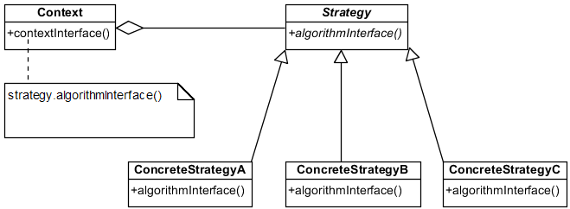
The Strategy Pattern
Notes:
This is the general class diagram of the Strategy Pattern. In the version we described, our Strategy is an interface such as FlyBehaviour, and it is implemented by Concrete Strategy classes such as FlyWithWings. Furthermore, the strategy would have an algorithmInterface() method, which in our example is the fly() method, which has to be overridden by all the Concrete Strategy classes. This version uses abstract classes with abstract methods and inheritance, which would work also. The key, though, is that the context, which is the class that uses the strategy, would || contain an object of type Strategy. The context in our example would be Duck, and it contains an attribute of type FlyBehaviour. In addition, it would have a contextInterface() method such as performFly(), that simply calls strategy.algorithmInterface(), so whatever is the ConcreteStrategy object assigned as the strategy, that is the version of algorithmInterface() that is called.

Slide 22
Key Participants
The Strategy defines an interface common to all supported algorithms
The ConcreteStrategy implements the algorithm using the Strategy interface
The Context
Maintains a reference to a Strategy object
Is configured with a ConcreteStrategy object
May define an interface that lets Strategy access its data
Notes:
Let’s review. The || Strategy defines a common interface for all the supported algorithms. So FlyBehaviour is the Strategy that defines the common interface for all flying behaviours, specifically, the fly() method.
The || ConcreteStrategy implements the algorithms that use the Strategy interface, such as FlyWithWings or FlyWithRocket.
The || Context class has a reference to a Strategy object, and this reference is assigned an object of type ConcreteStrategy. If necessary, it can allow the Strategy to access its data using getters and setters. And those are all the key participants to the Strategy design pattern.

Slide 23
Ducks Revisited
Strategy
Algorithm Interface
Context Interface
Context
Concrete Strategies
#
#
Strategy
Concrete Strategies
Notes:
Finally, let’s see how our Duck simulation maps to the Strategy pattern. Here is the class diagram of the Duck simulation game. || Duck is the Context, and it has access to the different strategies through the attributes flyBehaviour and quackBehaviour. || FlyBehaviour and QuackBehaviour are Strategies, which define an interface for the algorithms. In the case of FlyBehaviour, its|| algorithm interface is the fly() method. We then have the || Concrete Strategies that implement the Strategies, such as FlyWithWings and FlyWithRocket, that all have to implement their own version of fly(). Finally, all the magic happens because the || performFly() method in the context, known as the context interface, calls the FlyBehaviour’s fly() method, which is implemented by the interface’s subclasses.

Slide 24
Wait a minute…
Isn’t the State design pattern class diagram exactly the same as the Strategy design pattern?
Yes! But they differ in intent
State is an alternative to lots of conditionals
Strategy is a flexible alternative to subclassing
Notes:
Wait a minute! This looks extremely familiar. The Strategy Pattern class diagram looks EXACTLY the same as the State Pattern class diagram. Doesn’t that mean they are the same thing? Well, || yes, but also no. The State and Strategy patterns are the same proposed solution, but they differ in intent.
If you recall, the State Pattern encapsulates behaviours in state objects and at any time, the context calls one of these states. The current state changes across the set of state objects to reflect the internal state of the context, so the context’s behavior changes as well. The client object knows very little, if anything, about these state objects. This makes it much more convenient and less error-prone to maintain than || putting lots of conditional statements in the context.
In contrast, the Strategy pattern provides flexibility to change the algorithm to execute at runtime depending on which strategy is most appropriate. For example, in the duck simulation game, some ducks fly with typical flying behavior (like the MallardDuck) while others do not fly (like the RubberDuck and DecoyDuck). If we use inheritance and subclassing, then Mallard ducks will always fly by flapping their wings. But if my MallardDuck character picks up a rocket during runtime, the Strategy pattern allows me to change my flying behaviour on the fly (heh, get it?). Therefore, the || Strategy Pattern presents a flexible alternative to subclassing.
So essentially, we have one solution for two somewhat different problems. We just gave them different names, that’s all.

Slide 25
Summary
The Strategy design pattern
Design Principles
Encapsulate what changes
Has-a is better than Is-a
Notes:
And that was the Strategy design pattern. We explained how it works and why it’s a good idea if you are trying to code a system where the algorithm to use could change depending on circumstances. We also introduced a couple of new software design principles, namely to encapsulate what changes, and the fact that composition is usually better than inheritance. The Strategy design pattern is a solution that applies these principles to produce a design that is more flexible, extendible and maintainable.
Anyway, I think an actual duck simulation game would be very amusing. In fact, I’m sure it will quack me up. Then he waddled away (waddle waddle), till the very next day (bom bom bom bom bom badom)…

